Slide 1

FemtoClouds: Leveraging Mobile Devices to Provide Cloud Service at the Edge
2015 IEEE 8th International Conference on Cloud Computing
CIS-490H With Dr. Zheng Song
A Paper Review
By Demetrius Johnson
1-25-2023
Notes:
NOTE: “FEMTO” = 10^-15; thus “FemtoCloud” is referring to a very tiny cloud, namely mobile devices that act as very tiny cloud computational resources in a networked environment.

Slide 2

About the Authors
Karim Habak*, Mostafa Ammar*, Khaled A. Harras†, Ellen Zegura*
*School of Computer Science, College of Computing, Georgia Institute of Technology
†Computer Science Department, School of Computer Science, Carnegie Mellon University
Emails: *{karim.habak, ammar, ewz}@cc.gatech.edu, †kharras@cs.cmu.edu
Notes:
I think the background of authors is extremely important so that you can understand certain biases and the credibility of each author.

Slide 3
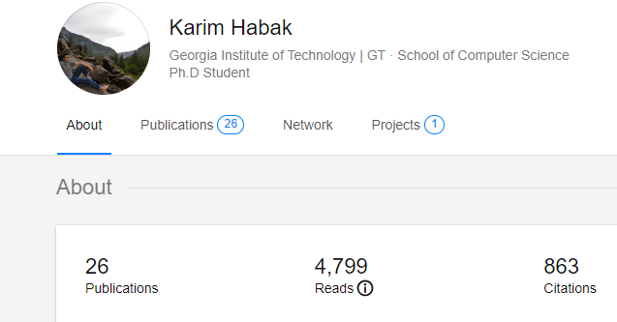
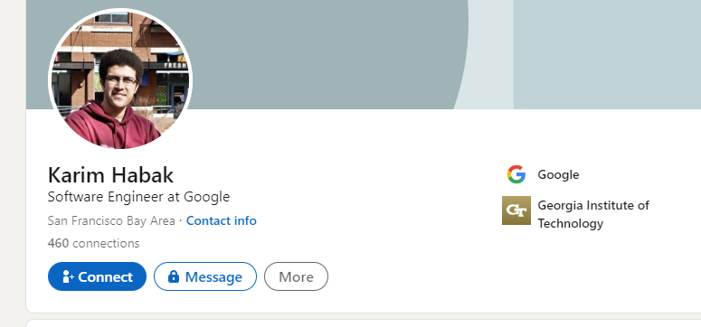
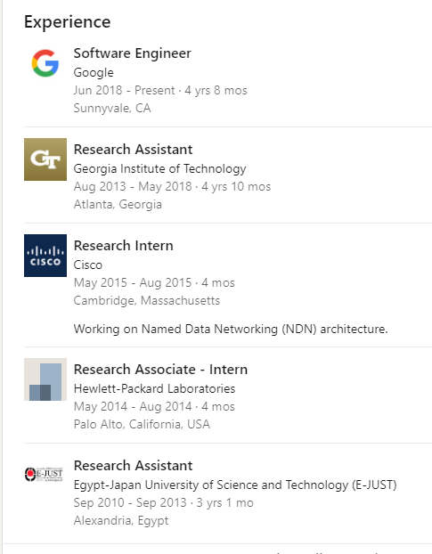

Notes:
https://www.researchgate.net/profile/Karim-Habak
https://www.linkedin.com/in/karimhabak/

Slide 4
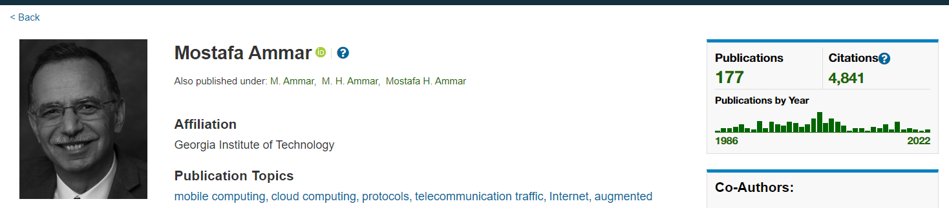

Notes:
https://ieeexplore.ieee.org/author/37271820200?searchWithin=%22Author%20Ids%22:37271820200&searchWithin=femto&history=no&highlight=true&returnFacets=ALL&returnType=SEARCH&sortType=newest
https://www.facebook.com/mostafa.ammar.528/

Slide 5
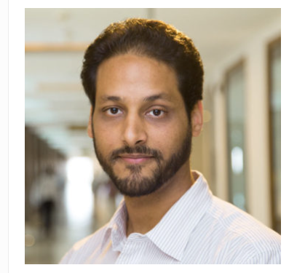
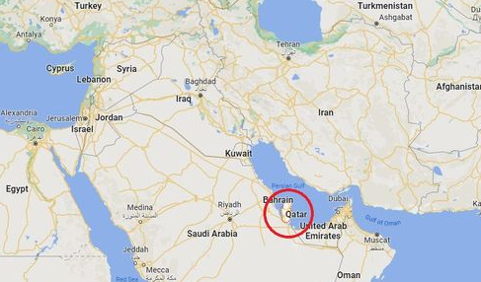
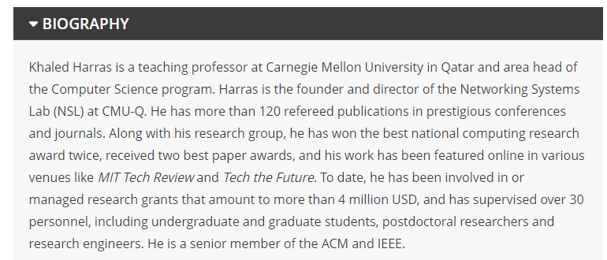
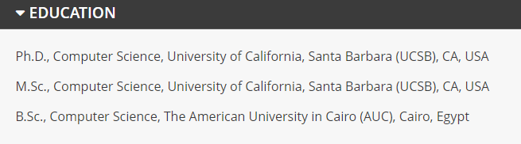
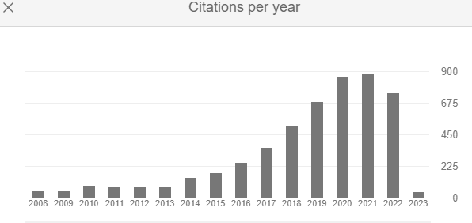
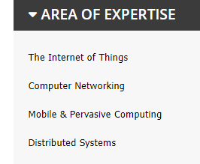
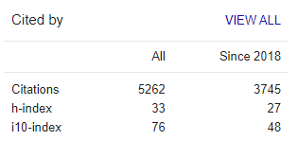
Khaled A. Harras
Notes:
https://scholar.google.com/citations?hl=en&user=V0UAZO0AAAAJ&view_op=list_works
https://www.qatar.cmu.edu/directory/khaled-harras/
According to google scholar only about

Slide 6
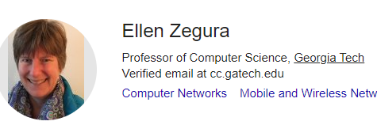

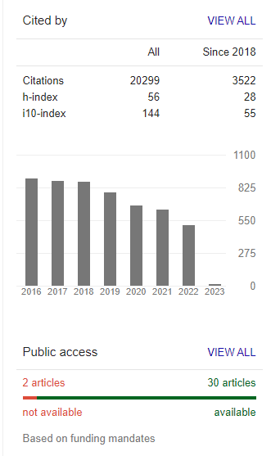
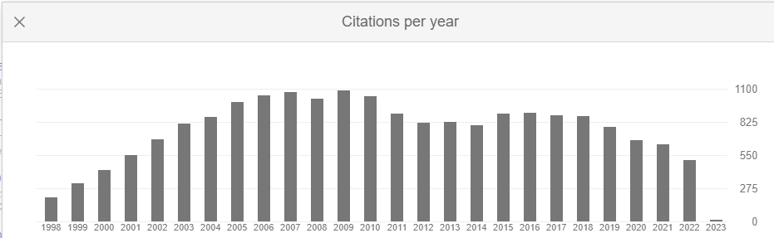
Notes:
https://scholar.google.com/citations?user=Z6EHuGcAAAAJ&hl=en

Slide 7
I. Introduction
(and V. Related Work)
NOTE: “FEMTO” prefix = 10^-15
In addition to questions of performance speedup, energy savings and cost, the key questions for an offloading system design are: where is the higher performance capacity, who provides it, and how does it fit into a larger computing ecosystem?
Notes:
So now I see the primary fault of cloud computing: Latency because data centers are located so far away, and (also) the bottleneck is bandwidth constraints along the (internet) path from user devices to the data center.
Other than that, the Cloud cannot be beat and has best efficiency and lowest cost and elastic/scalable infrastructure, with practically unlimited computing power.
Edge computing is essentially: bringing computational power closer to end devices→ bring the cloud computing devices closer so that latency is reduced from not only raw distance to cloud device, but also from reducing bandwidth along the path to that cloud computing device
This can of course reduce bandwidth strain in the entire internet, particularly along paths to data centers.
Original name for servers closer to users is dubbed “cloudlet” servers.
One idea is to refactor cloudlet into a controller that distributes computational tasks amongst a cluster of user (or other edge) devices.
This is dubbed as “FemtoCloud”

Slide 8
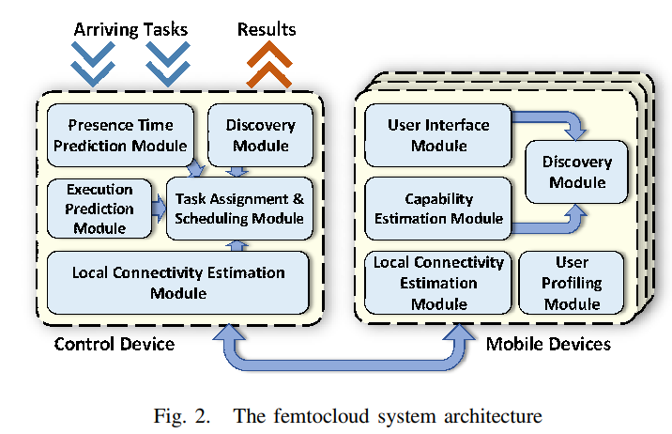
II. FemtoCloud System
Assumptions
System Architecture
Implementation
Notes:
Assumptions: Users have FemtoCloud client program running on their device…willing to share their computational resources…complete task and send to controller before leaving cluster
Controller will use profile data to set up and assign the cluster devices tasks to run.
Possible issue: femto clients leverage their input data and usage history to build a profile (for determining computational capability and availability).
So we have to assume here that the client already collects this data naturally (and enough of it to get proper/usable estimations), else then perhaps clients could end up spending additional resources and energy consumption on building AND maintaining these user profiles. Something to think about.
Note: BOINC client-server technology is used so that servers can send tasks to clients → BOINC is proposed to be used in this femto cloud setup.
Note, in the FemtoCloud system, the cloudlet device (edge server) dedicates its computational resources to managing client nodes for service or serving.

Slide 9
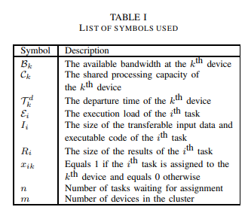


III. FemtoCloud Scheduling Problem
Scheduling as Optimization
Heuristics (Task Assignment, and Results Gathering)
Alpha = safety factor (a buffer → Time needed + extra).
Notes:
Optimization metric: “focus on maximizing the “useful computation”, defined as total computation completed by the system.”
“We begin by formulating the problem as an optimization problem, assuming perfect knowledge of device capabilities (computation and bandwidth) and departure time.”
Goal is to determine a complete task-execution schedule.
∀ This symbol means for all (or sometimes, for every). For example, “∀ squares D, D is a rectangle”
Maximization formula basically says: find a way to make it so that the completed computational load is = SUM of the execution loads of all tasks (including tasks that are duplicated to be processed by several devices in case a device leaves, and also devices that are assigned more than one task).
Without using math symbols they add these constraints to the optimization problem:
each task should be assigned to at most 1 device
Assume upload, execute, and transmission of results of a task is sufficient
All results must be stored on controller before device leaves
No concurrent executions on devices that are assigned more than 1 task
Controller not allowed to transmit task and receive results of tasks at the same time.
HEURISTICS
Scheduling heuristic: we adopt an iterative greedy approach to assigning tasks to mobile devices
the controller assigns as many tasks as it possibly can before a results gathering event is triggered by our results gathering heuristics.
Results Gathering Heuristics: Determining when to start gathering the available results from the devices
Remember: assumption is that transmit tasks and receiving results is not allowed simultaneously to save wireless bandwidth
Premature gathering of results wastes an opportunity of sending more tasks to the executing nodes and increasing computational throughput.
Late gathering, however, risks wasting a portion of the results and having to reassign some incomplete tasks, which decreases the computational throughput.

Slide 10
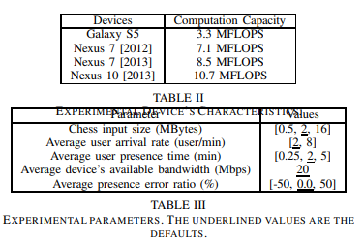
IV. Evaluation of FemtoCloud System
Experimental Setup
FemtoCloud Simulation Results
FemtoCloud Prototype Evaluation
Notes:
we develop, with different preset computational loads (MFLOPs) on a set of mobile devices. We summarize the results of this study in in Table II, which shows the average background thread capacity for the mobile devices.
We conduct another measurement study to determine the compute resource usage of different real applications. Table IV summarizes this study and shows the compute resource usage of the following three applications
Computational Throughput: This is the average amount of useful computations finished by our femtocloud per second (MFLOPS).
Compute Resource Utilization: This is the average utilization of the compute resources in our cluster. To calculate this utilization, we only consider useful computations, which belong to tasks completed by femtocloud.
Network utilization: This is the average busy time of the network for sending tasks or receiving results.

Slide 11
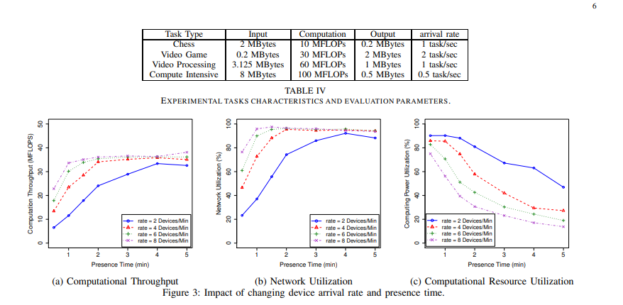
IV. Evaluation of FemtoCloud System
Experimental Setup
FemtoCloud Simulation Results
FemtoCloud Prototype Evaluation
Notes:
we develop, with different preset computational loads (MFLOPs) on a set of mobile devices. We summarize the results of this study in in Table II, which shows the average background thread capacity for the mobile devices.
We conduct another measurement study to determine the compute resource usage of different real applications. Table IV summarizes this study and shows the compute resource usage of the following three applications
Computational Throughput: This is the average amount of useful computations finished by our femtocloud per second (MFLOPS).
Compute Resource Utilization: This is the average utilization of the compute resources in our cluster. To calculate this utilization, we only consider useful computations, which belong to tasks completed by femtocloud.
Network utilization: This is the average busy time of the network for sending tasks or receiving results.

Slide 12
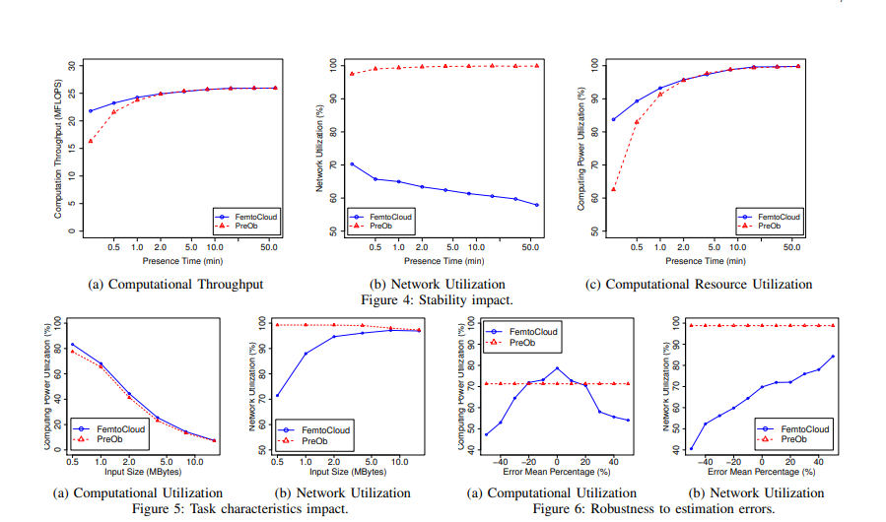
IV. Evaluation of FemtoCloud System
Experimental Setup
FemtoCloud Simulation Results
FemtoCloud Prototype Evaluation
Notes:
we develop, with different preset computational loads (MFLOPs) on a set of mobile devices. We summarize the results of this study in in Table II, which shows the average background thread capacity for the mobile devices.
We conduct another measurement study to determine the compute resource usage of different real applications. Table IV summarizes this study and shows the compute resource usage of the following three applications
Computational Throughput: This is the average amount of useful computations finished by our femtocloud per second (MFLOPS).
Compute Resource Utilization: This is the average utilization of the compute resources in our cluster. To calculate this utilization, we only consider useful computations, which belong to tasks completed by femtocloud.
Network utilization: This is the average busy time of the network for sending tasks or receiving results.

Slide 13
VI. Conclusion
Build on Cloudlet vision
IoT growth supports the vision
Hardware capabilities support the vision

Slide 14
Bigger Picture
Emergency Situations
Infrastructure hits
Opportunistic

Slide 15
Questions?
o___0

